Slide 1
ABOUT THE ORGANIZATION
Social Revival Group of Urban Rural and Tribal (SROUT)
Registered under Society Registration act – 1973
Date 0f Registration – 29/04/1999, Registration Number – 2492
Background and experience of the organization
The Social Revival Group of Urban Rural and Tribal (SROUT) is grassroots, non-governmental organization that works to promote and strengthen livelihood, education and health for the needy rural and urban people in the State of Chhattisgarh. SROUT began its journey in 1999 from Korba (now it is a district), Chhattisgarh to support the Program Integrated Nutrition and Health Program, organized by CARE-India. It worked as implementing agency for them and fulfill the expectation of CARE. Thus, SROUT was born and keeping continue its journey to this day to be involved in the development of local community. The organization was named the Social Revival of Urban Rural and Tribal because we are committed to working with local people, making no distinction based on where they reside or to which caste they belong. The Sanskrit quotation located on the bottom of our logo reads: thing is achieved by doing and not by desiring alone. This acts as the foundation of our organization and we strive to stay true to this in every aspect of our work.

Slide 2
Our Vision
Our vision is a society in which people live lives with dignity, prosperity and happiness.
Our Mission
Our mission is to end poverty by empowering the marginalized and vulnerable sectors of the community; providing them with the capacity to take ownership of their own development. Therefore, women and children are at the forefront of our work, as we address issues related to health and hygiene, education, the environment, gender empowerment, rehabilitation and resettlement, and livelihood promotion.

Slide 3
Registrations/Legal compliances
A society registered under M.P. Society Registration Act 1973.
Registration no – 2492, Date – 29.04.1999
Registered Address – H : 25 Irrigation colony, Darri, Dist – Korba (C.G.)
NITI Aayog - Unique ID – CG/2009/0015818.
Ministry of Corporate Affairs Registration number - CSR00001960
Income Tax 12 (A) : AAETS3216NE20142
80 G : AAETS3216NF20211
PAN No - A A E T S 3 2 1 6 N
Email – sroutkorba@gmail.com, sroutkorba@rediffmail.com
Website- www.sroutngo.org

Slide 4
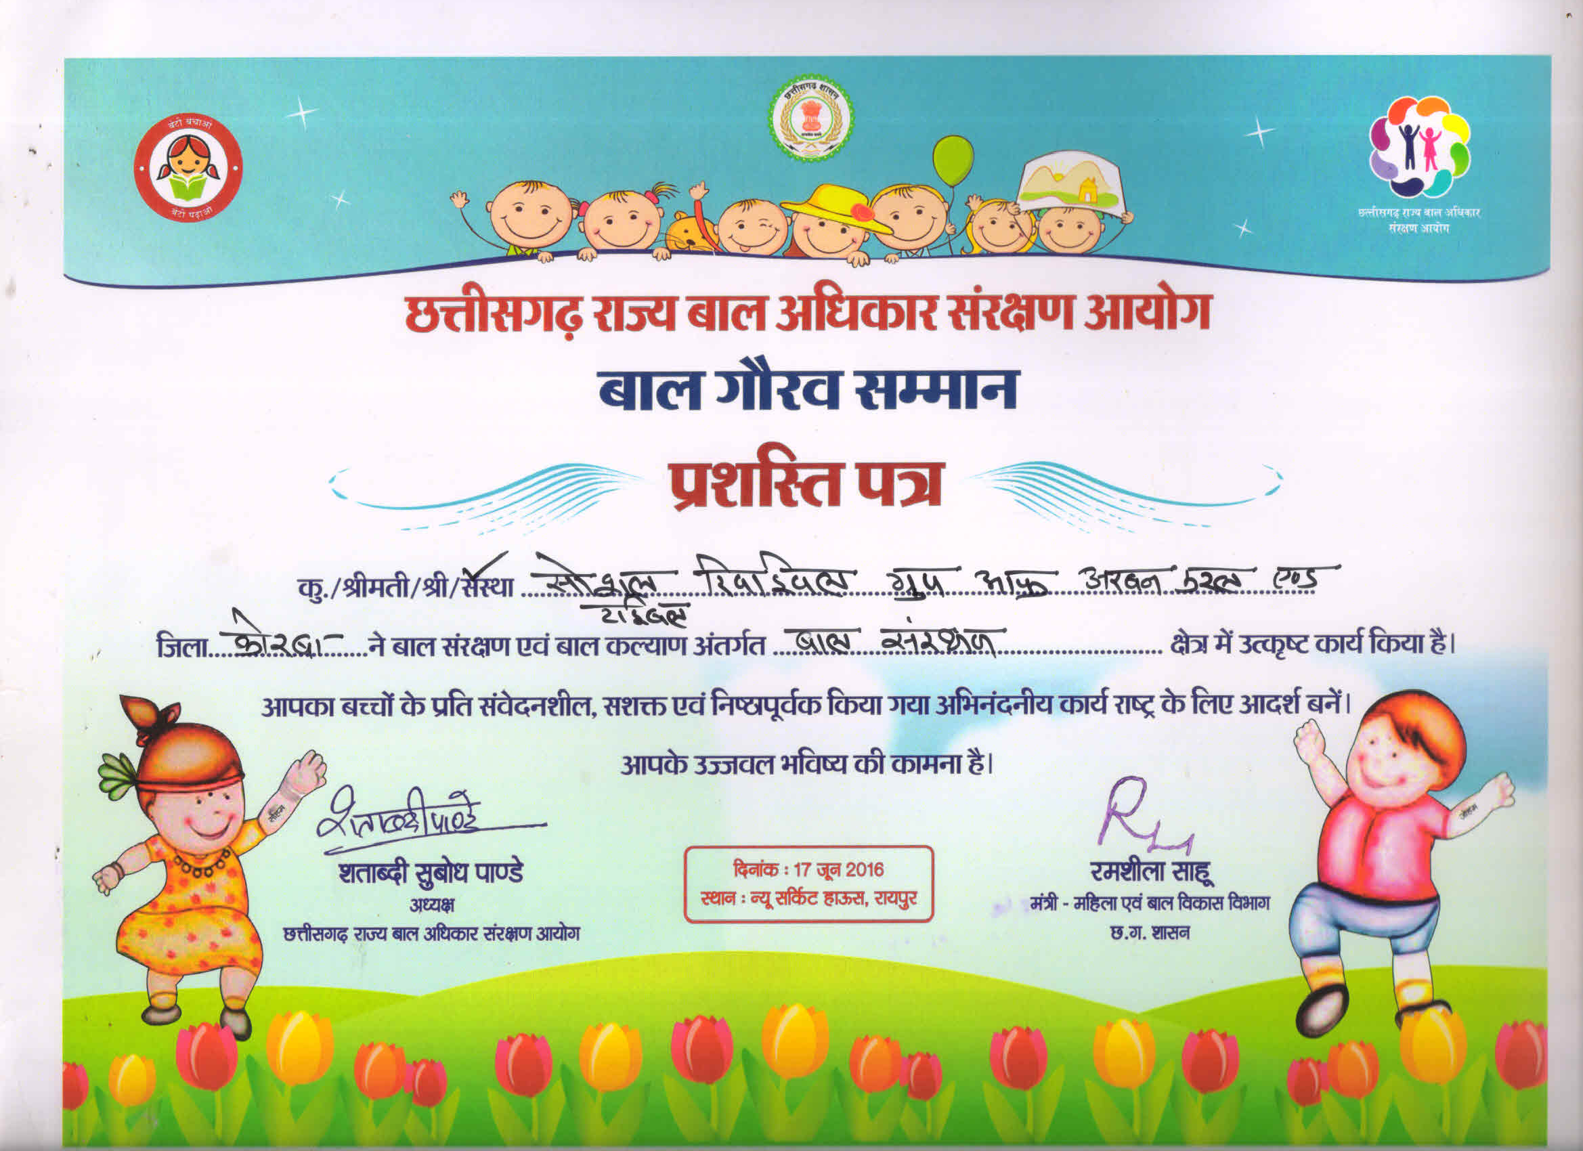
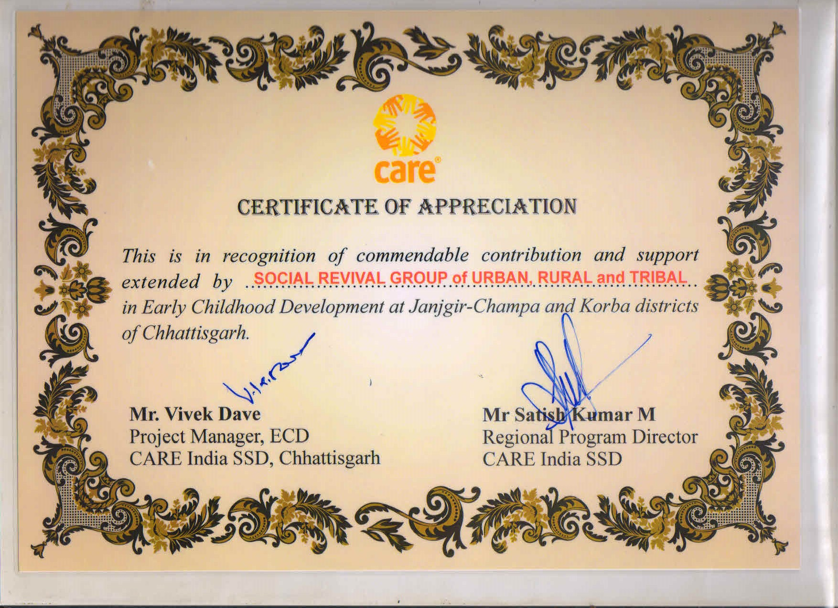
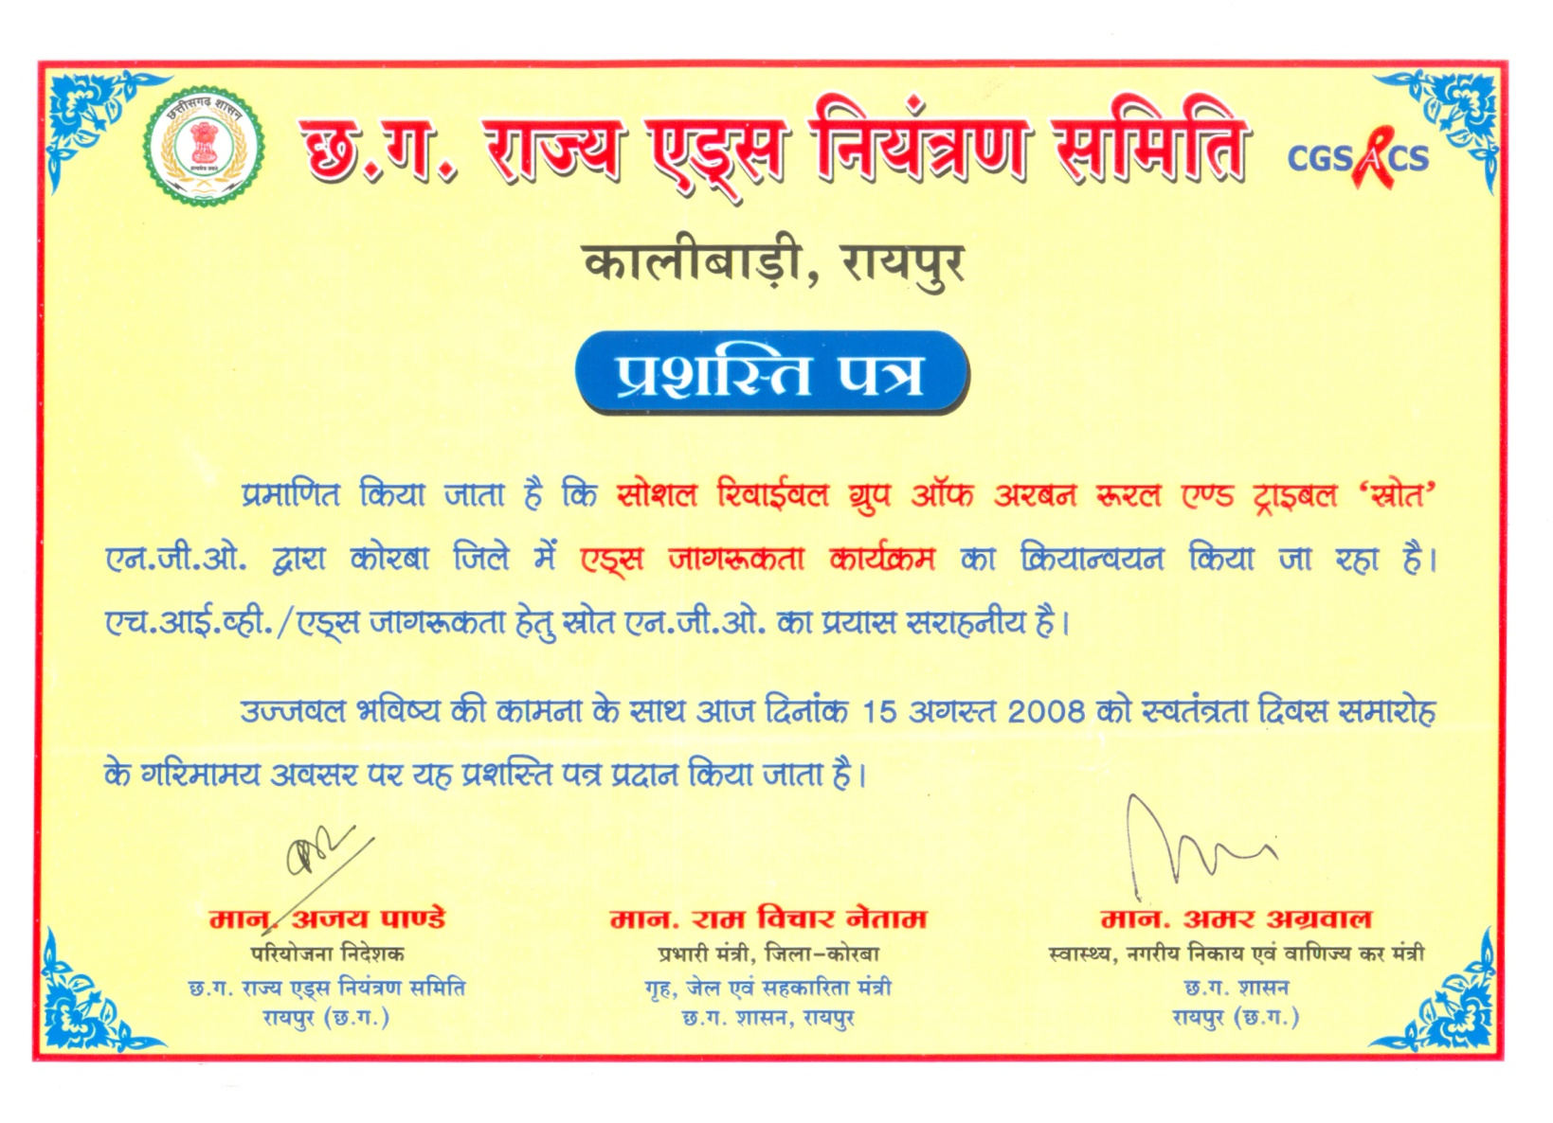
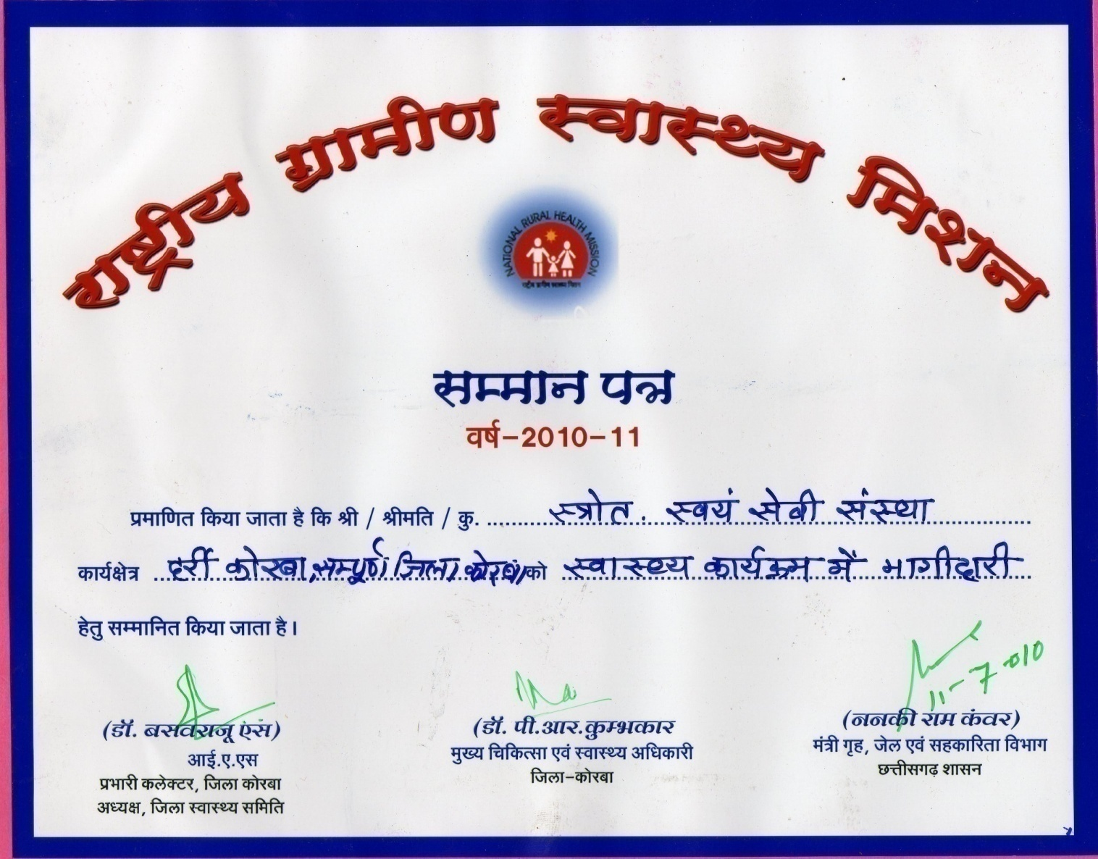
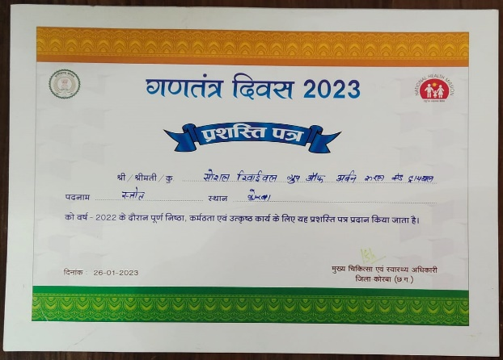
APPRECIATIONS AND AWARD

Slide 5
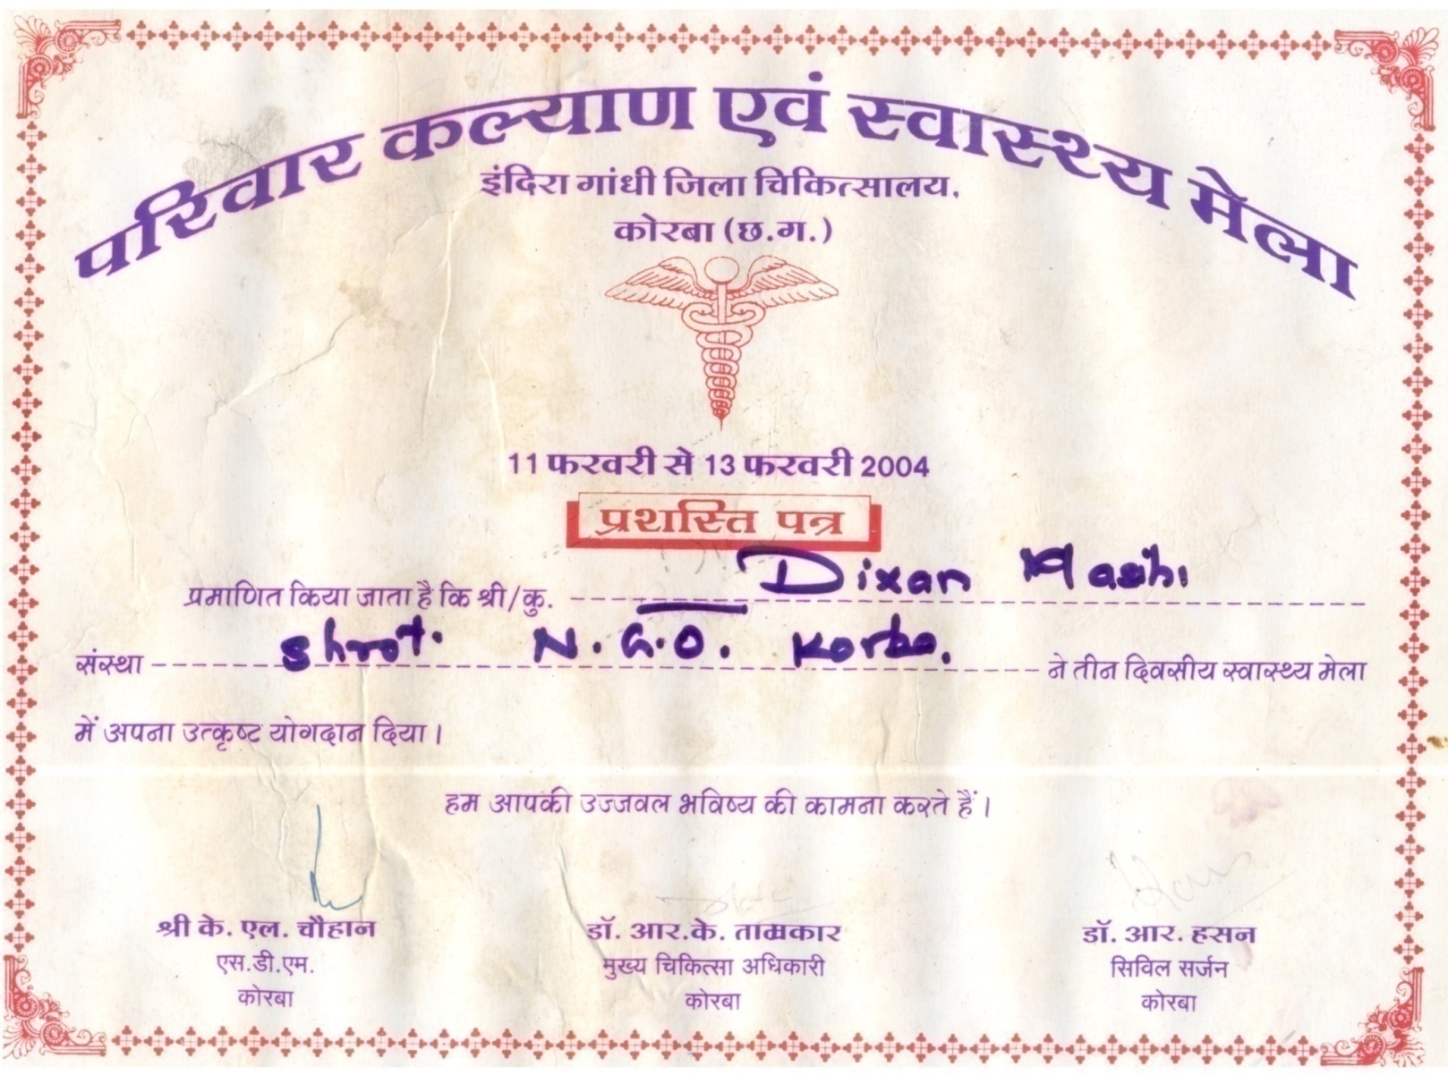
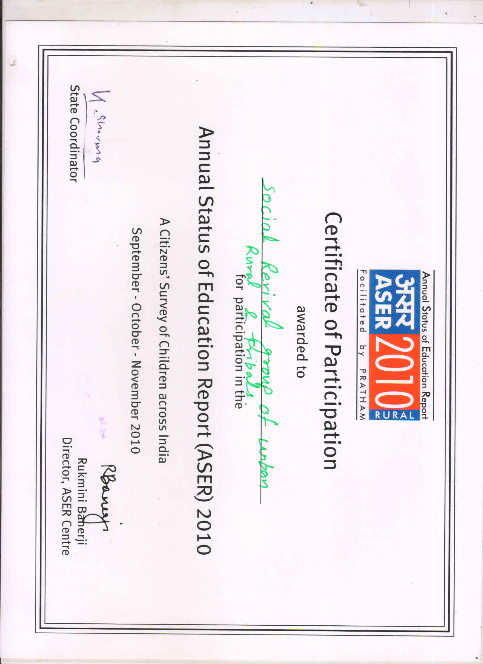
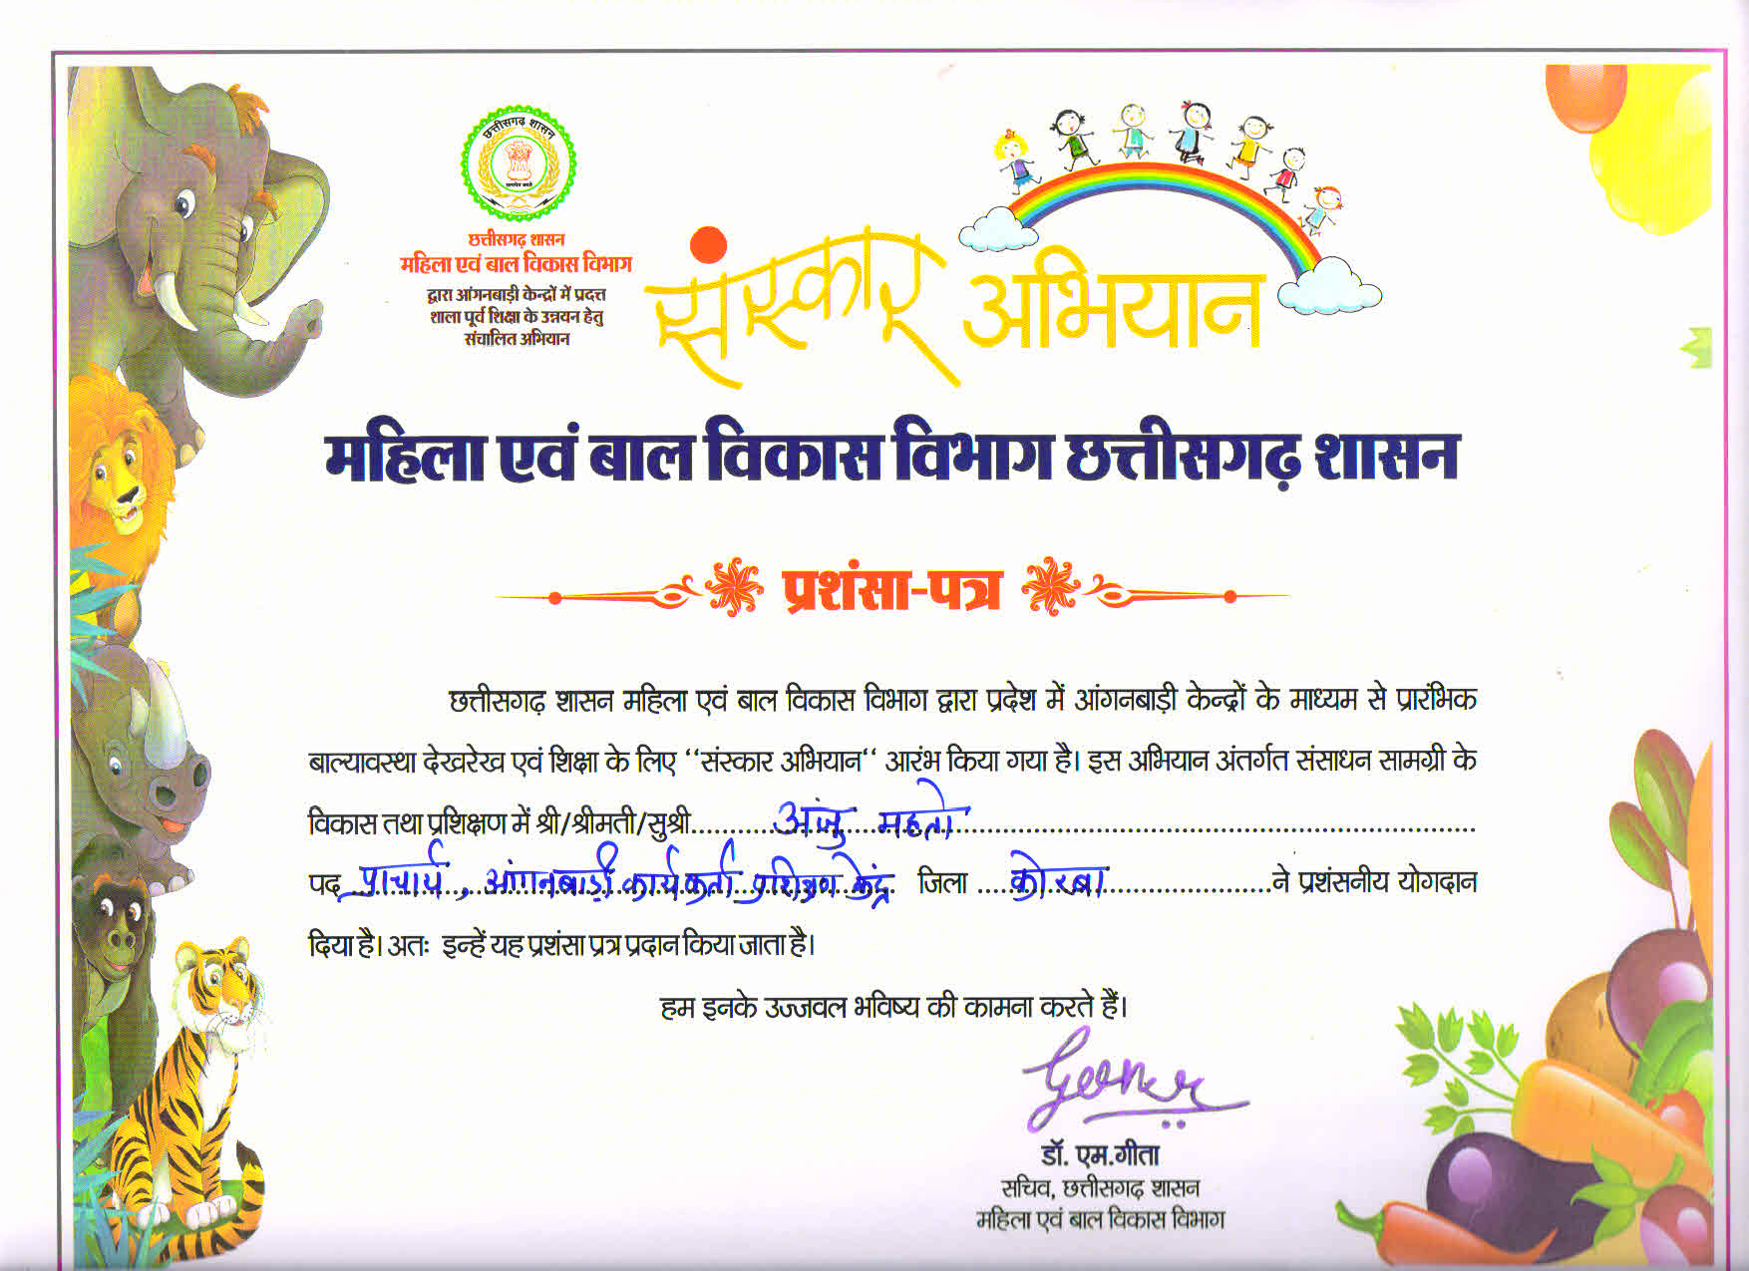

Slide 6
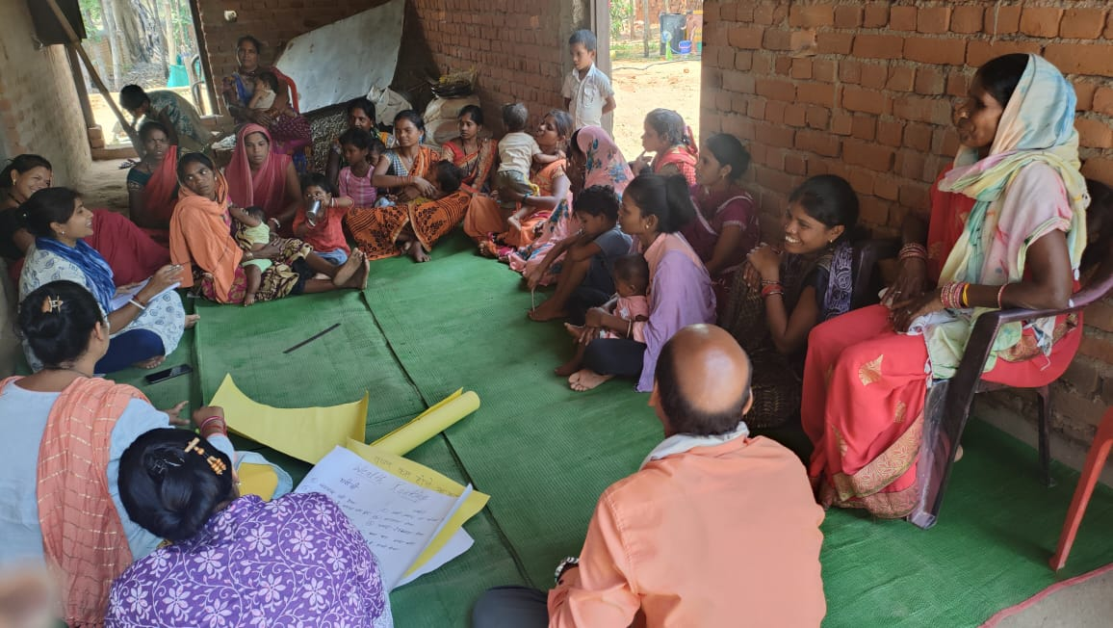
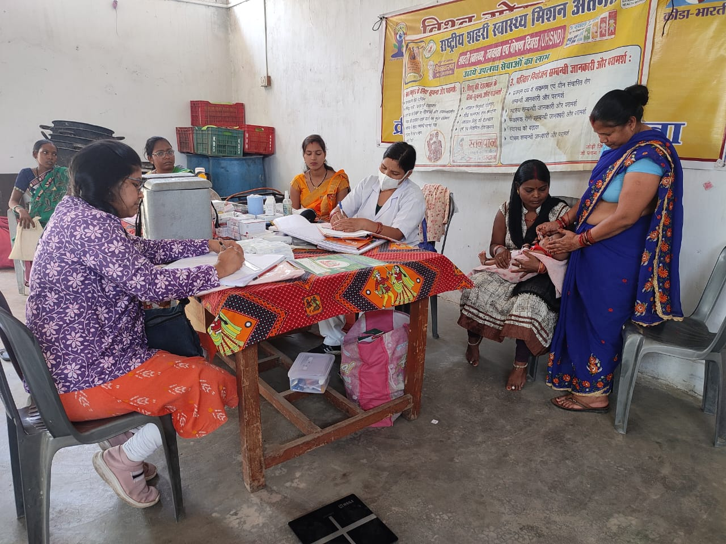
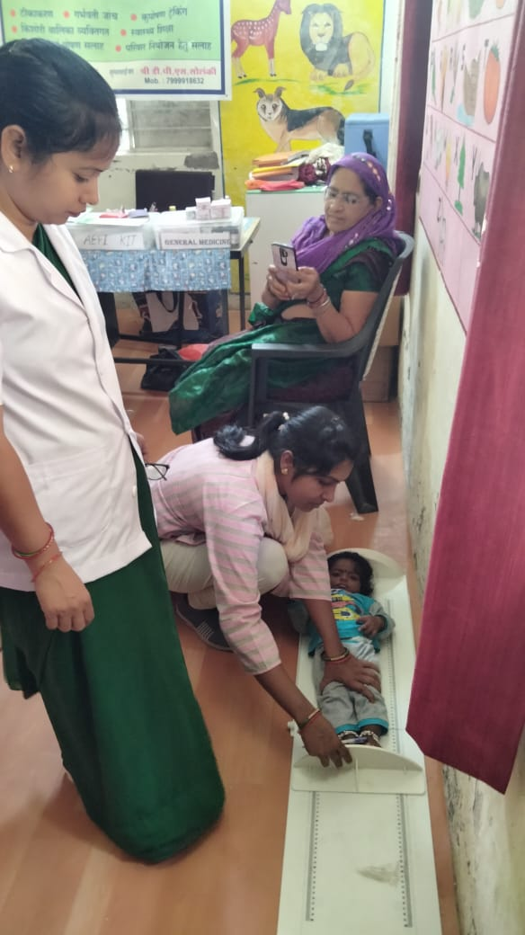
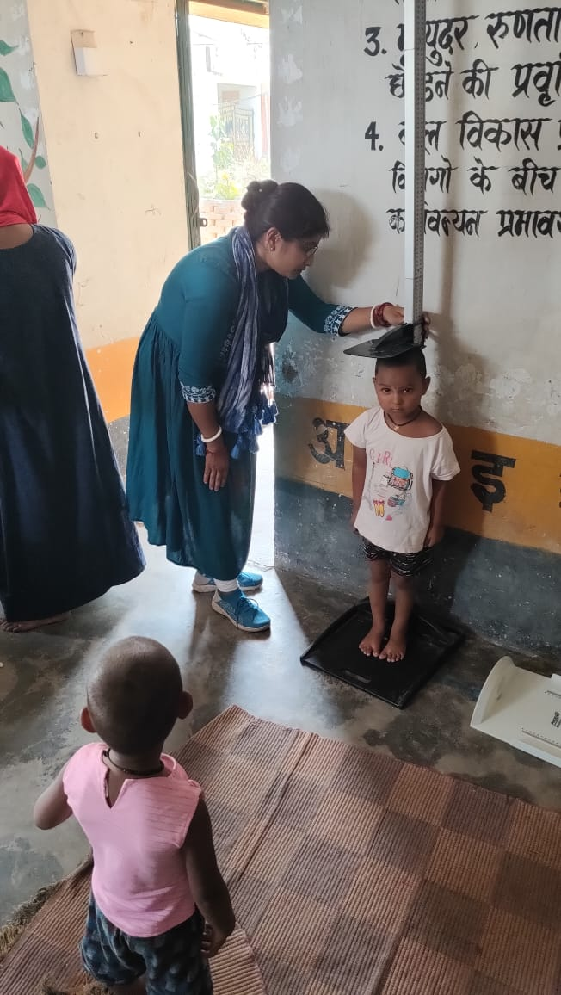
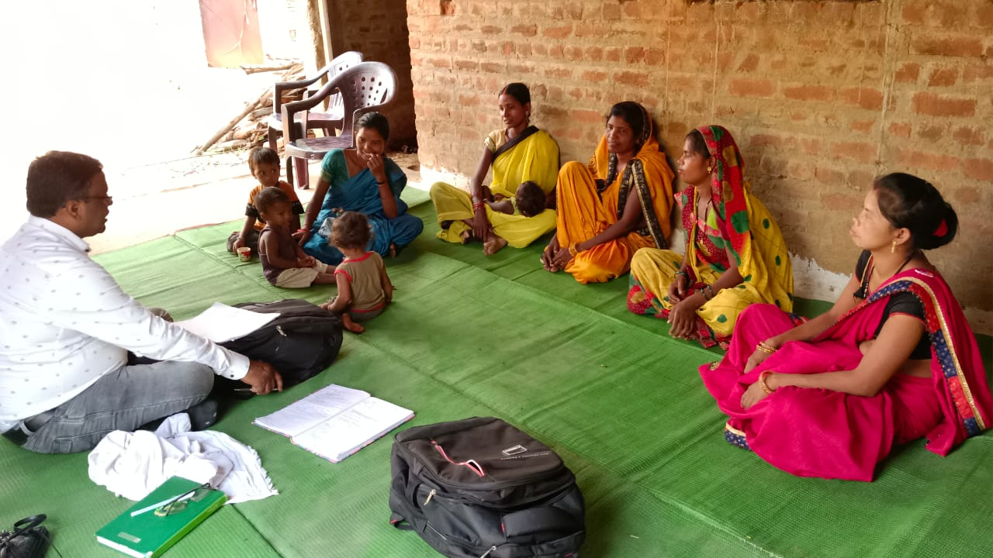
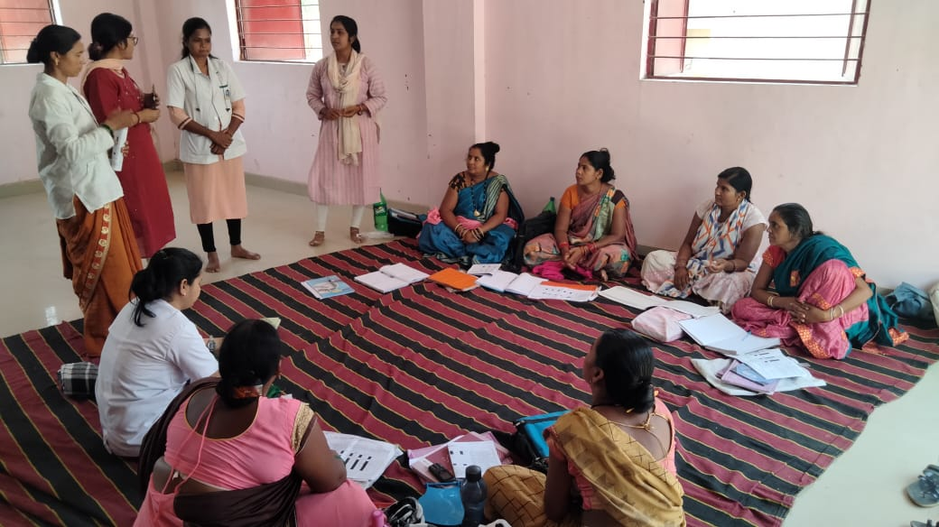
Photo Gallery:-
Focused Area:-
1. Health and Nutrition
2. Child Rights and Protection
3. Livelihood
4. Soil and Water conservation
5. Women Empowerment and protection
6. Education
7. Sanitation and Environment
8. Advocacy
9. Early Childhood development

Slide 7
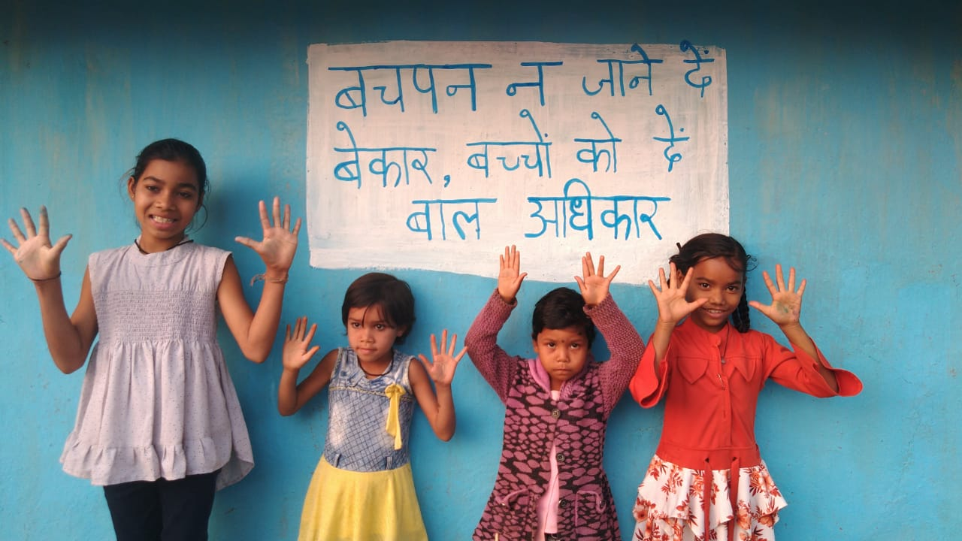
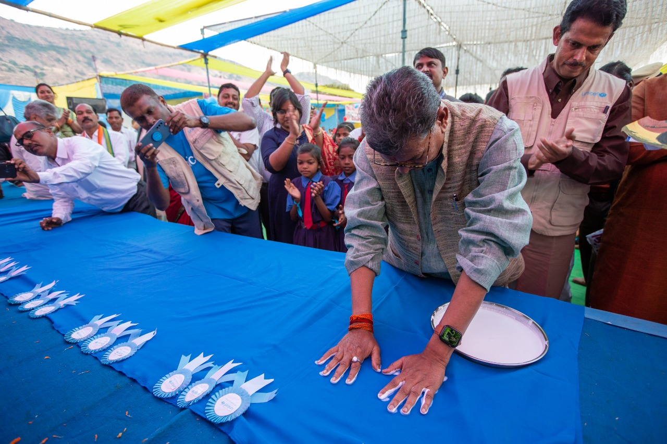
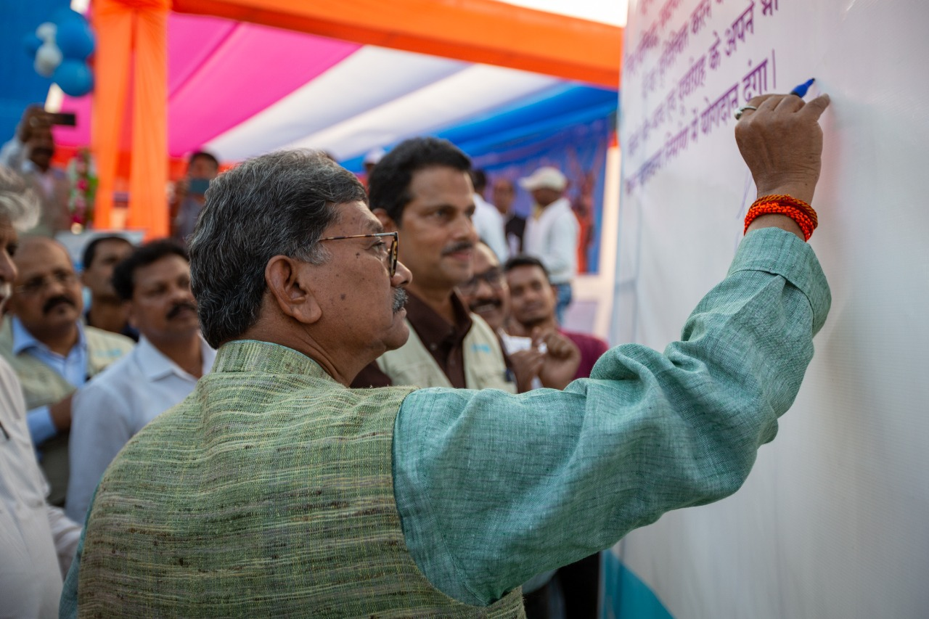
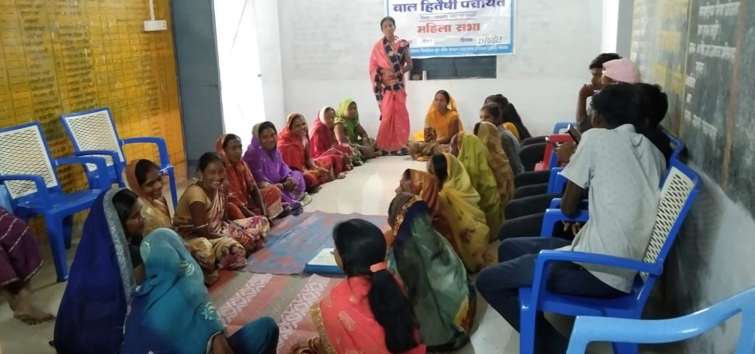
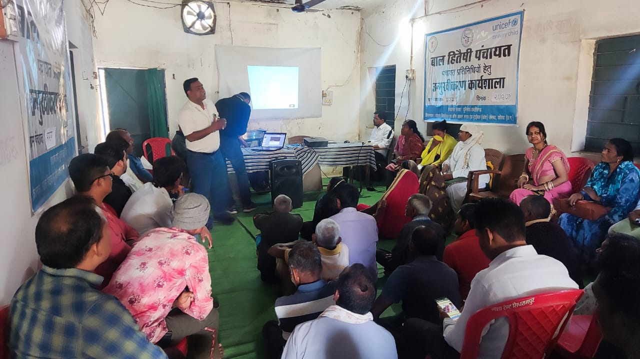
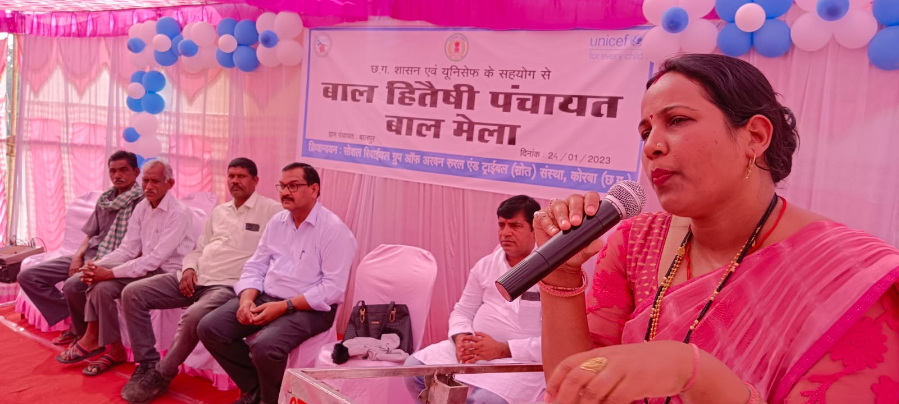
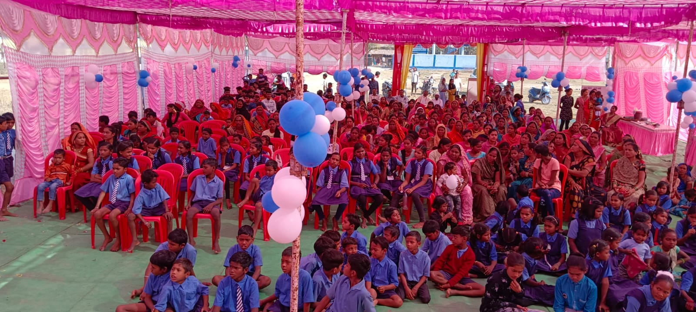
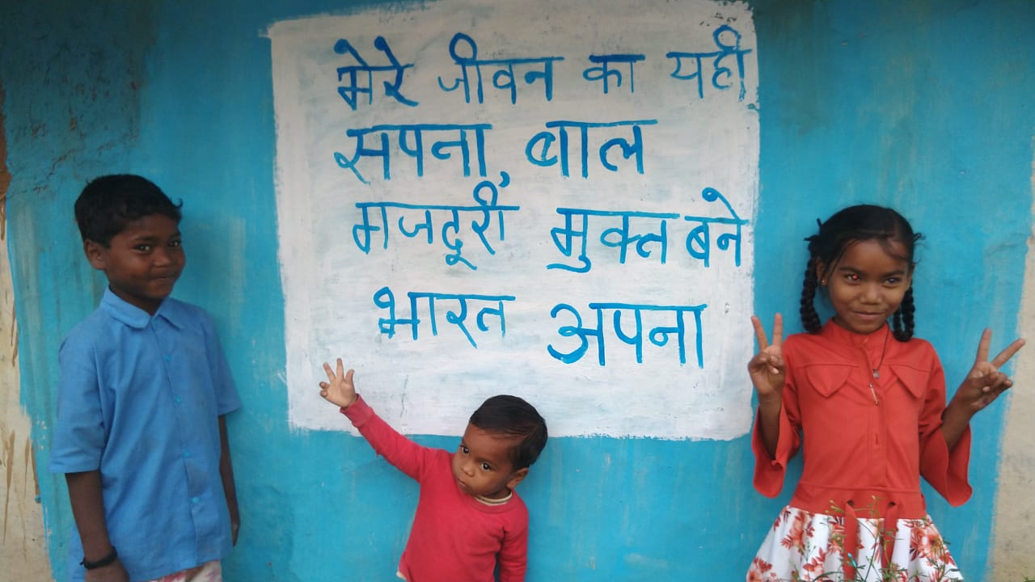
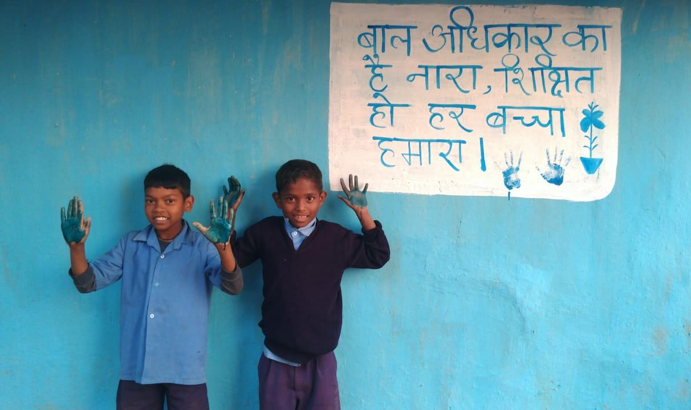

Slide 8
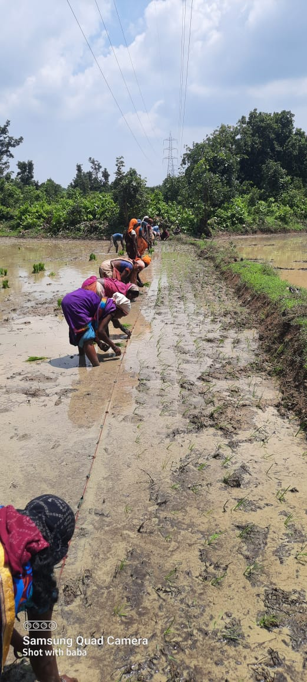
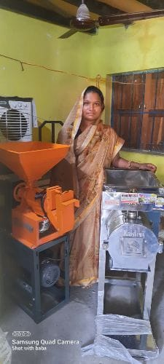
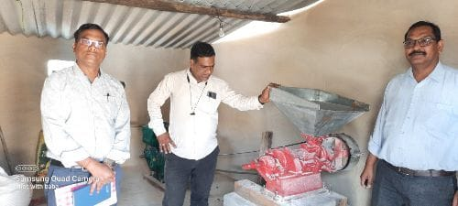
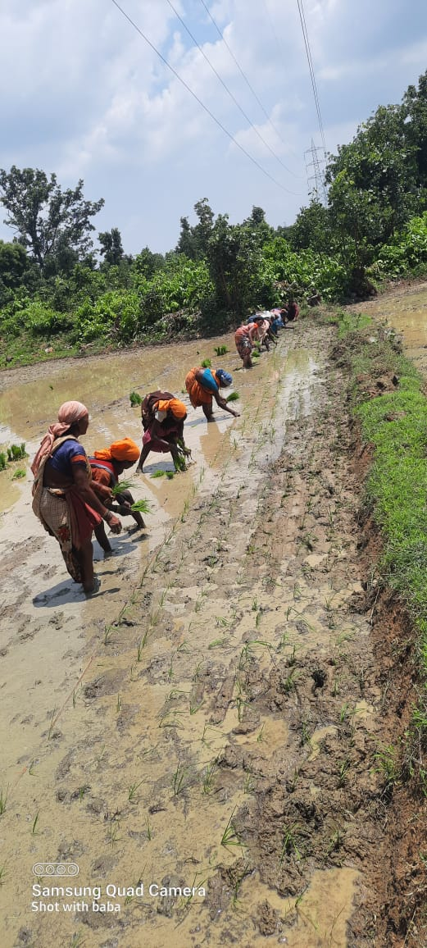
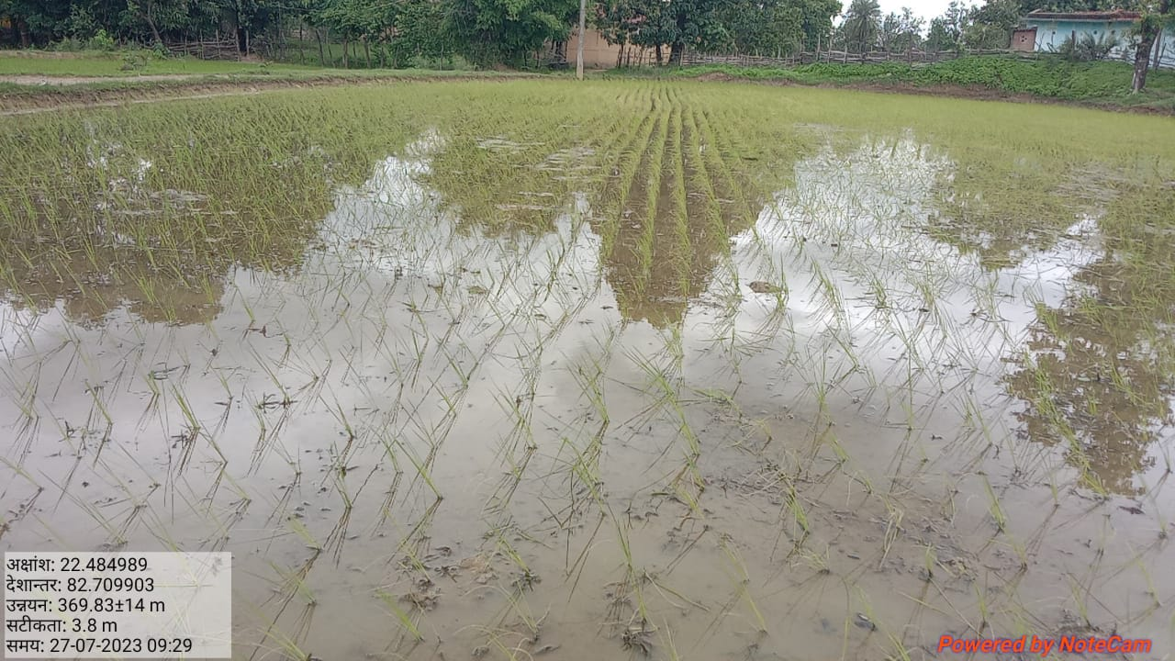
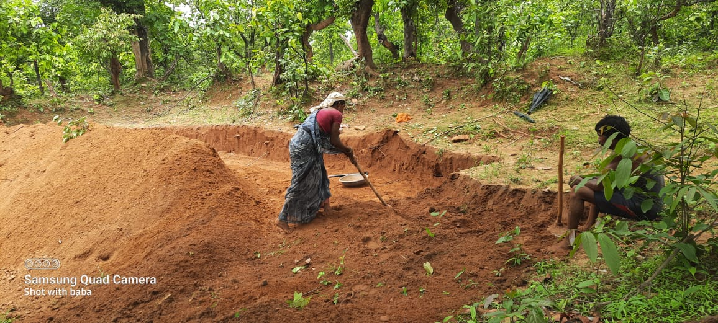
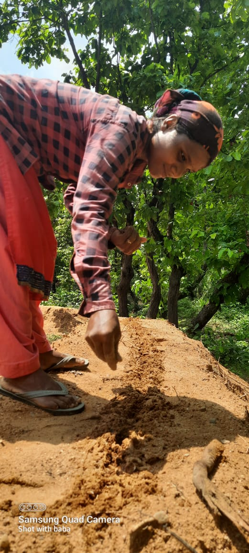
Livelihood Assistance
Water Shed program

Slide 9
Our Partner GOs-NGOs

Slide 11
CURRENT PROJECTS
AROGYA PROJECT
(CSR BALCO)
CHILD LINE (WCD)
WATERSHED (NABARD)
JJM
(PHED)
CHILD HOME (WCD)
FARMERS PRODUCERS ORGANIZATION (FPO)
UJJWALA (WCD)
BAAL SULABH PANCHAYAT (UNICEF)

Slide 12
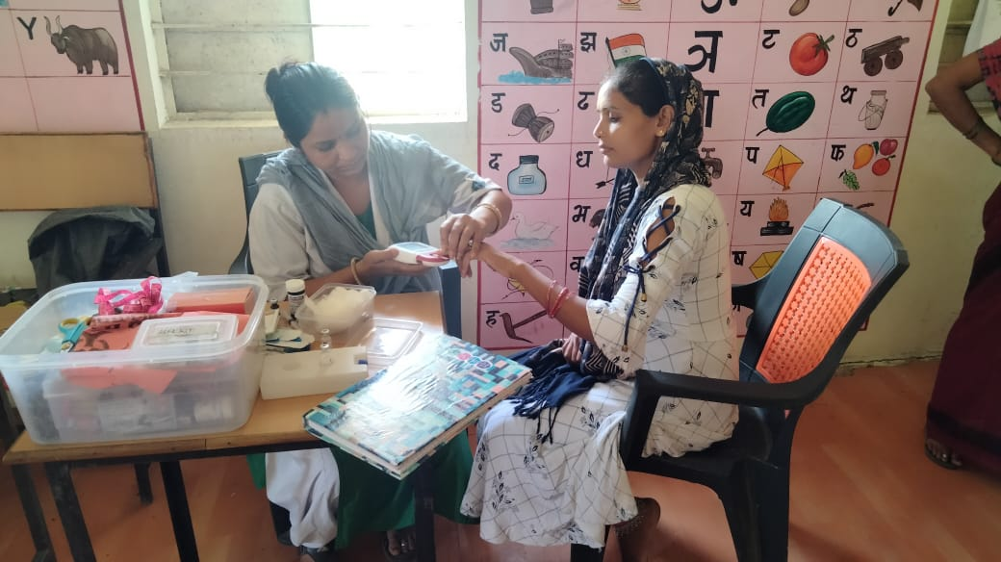
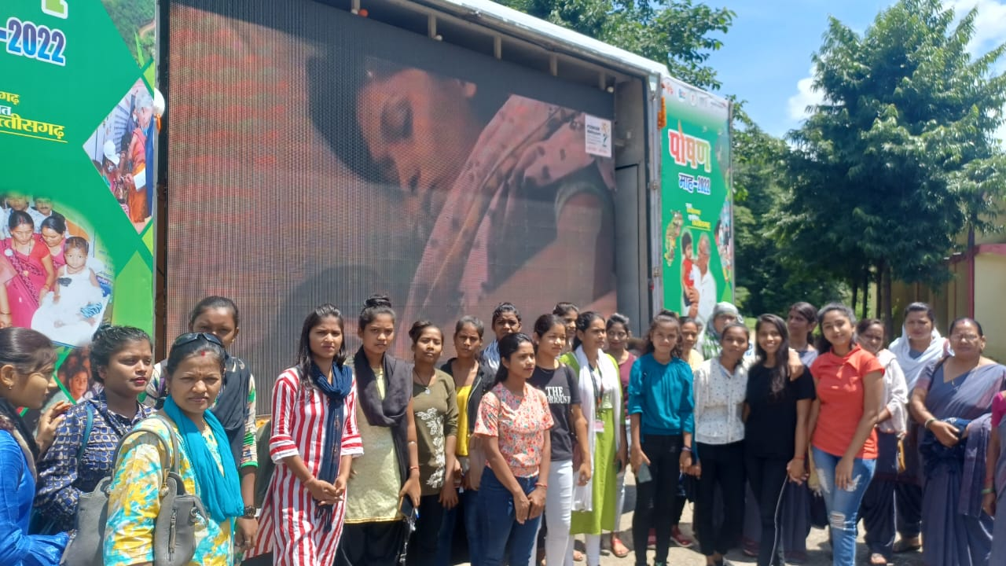
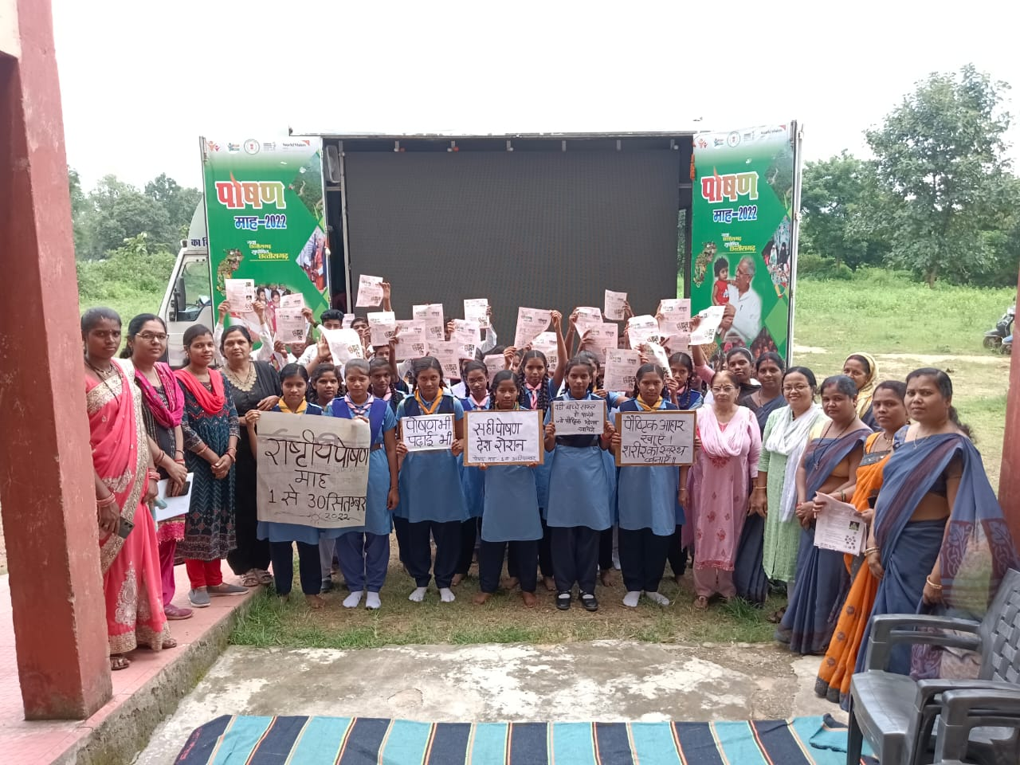
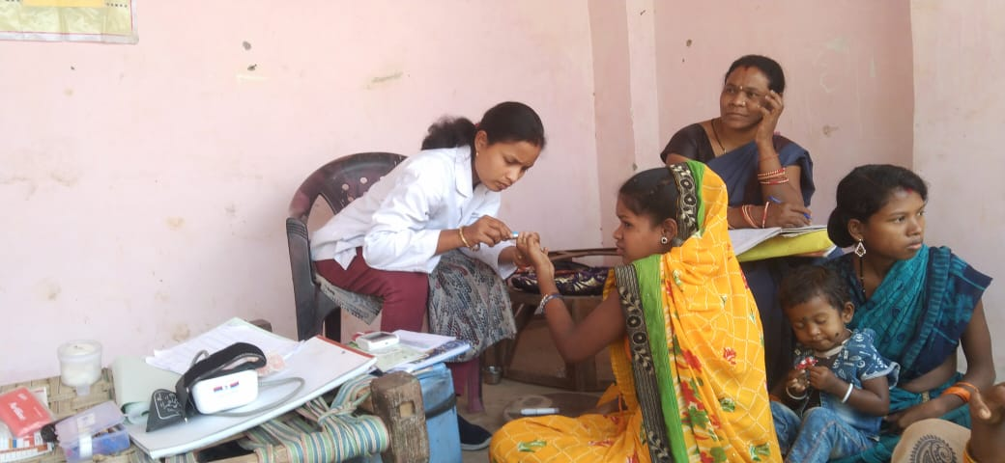
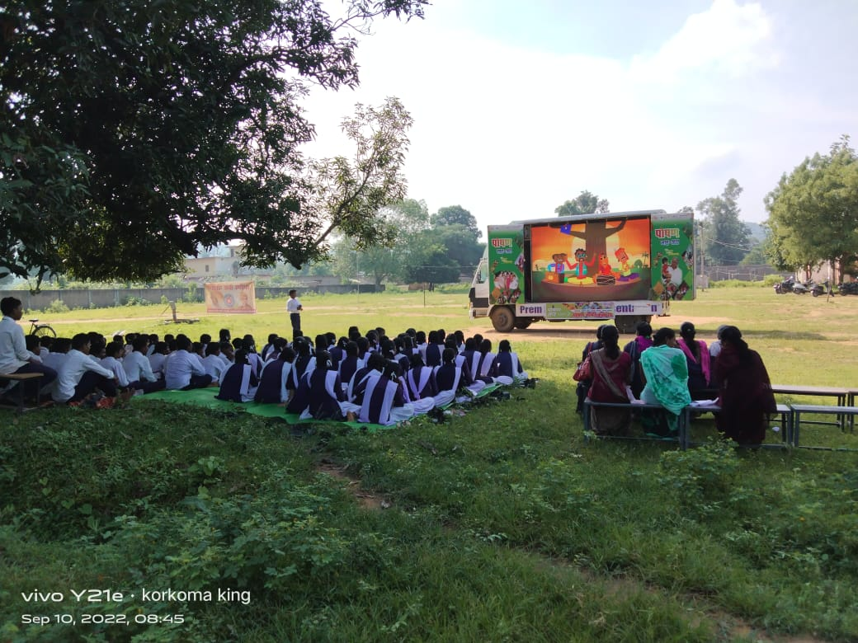
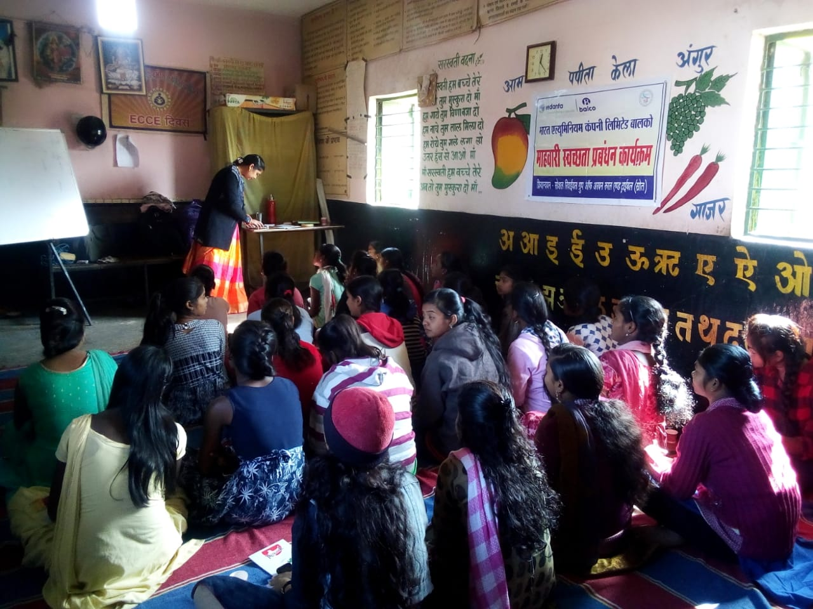
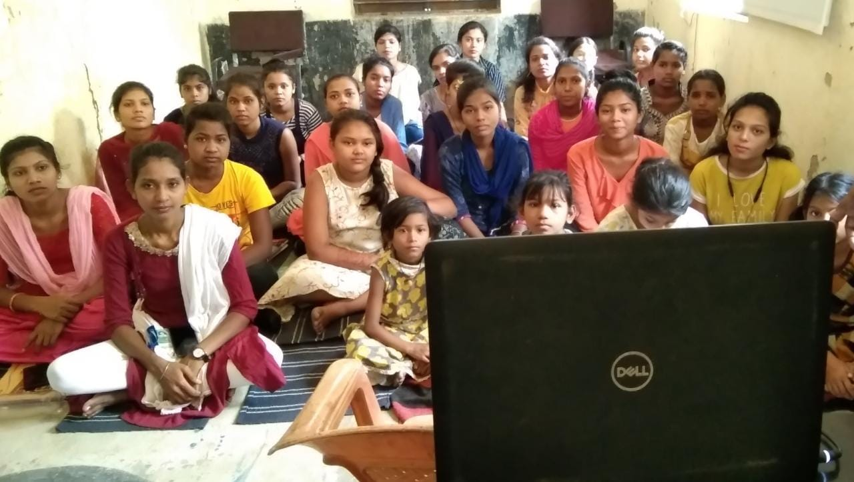
Anaemia Awareness
program
HB Testing
Anaemia counselling session

Slide 13
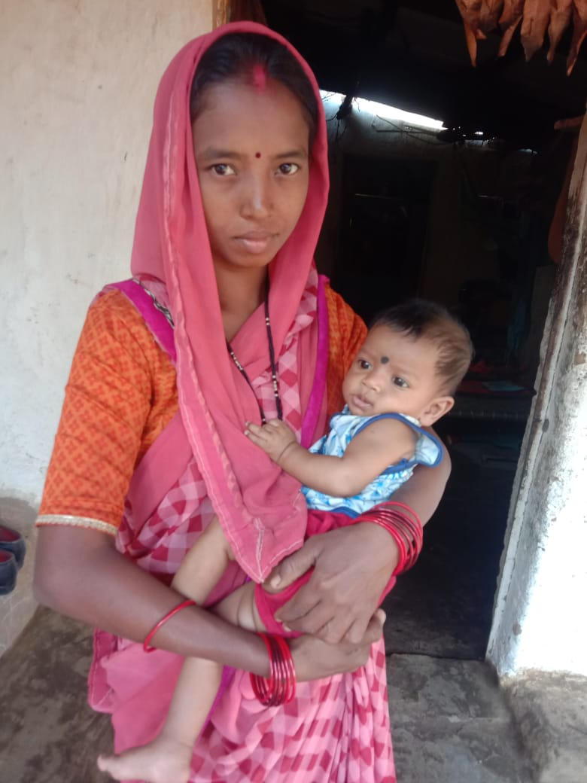
CASE
STUDY
NAME : Mrs Bhanu Yadav (28yrs) FROM DUGGUPARA
Problem: Sickle Cell- Conceived, Severe Anaemic – HB 6 gm, Complications
Action Taken: When she was identified in 5th month of conception with the help of Mitanin, regular home visit has been done to counsel her for routine check-up, healthy diet, awareness of danger signs and symptoms etc. She was given Poshan badi also which has helped her a lot to improve her health during pregnancy. Doctors by looking at her complications had suggested her not to take the child but when she was asked to go for second opinion with another doctor; after which she was very positive and was willing to adopt good practices.
Transformation: She delivered a healthy girl child (3kg) and her delivery was normal. During delivery her HB was 8 gm. She is very thankful to project staff for being her support during need and proper guidance.

Slide 14
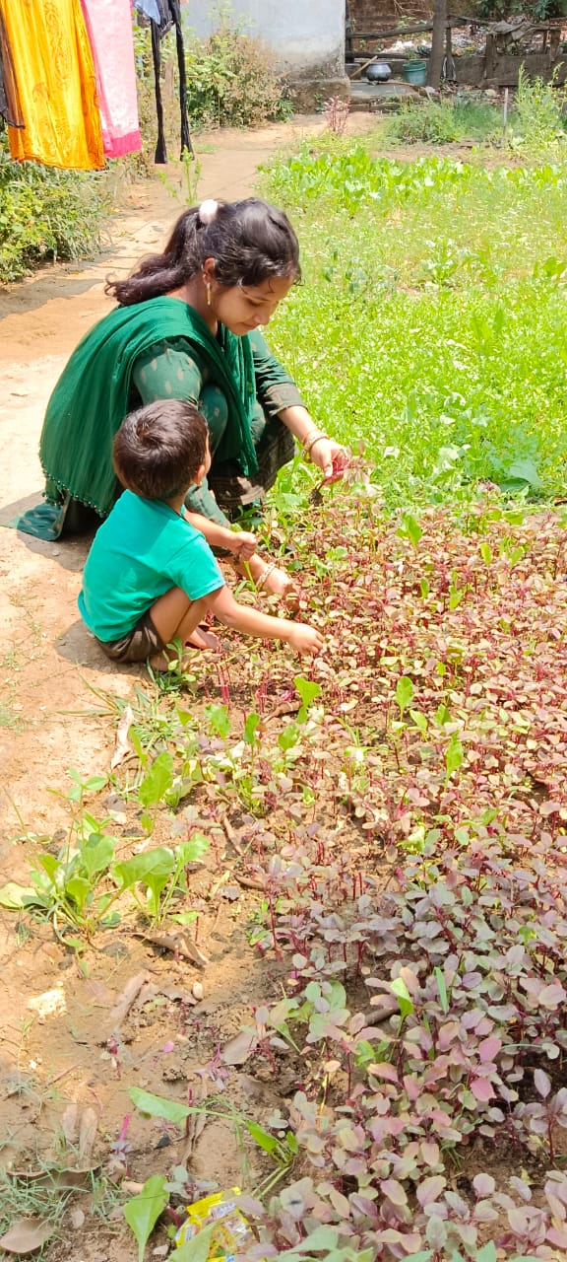
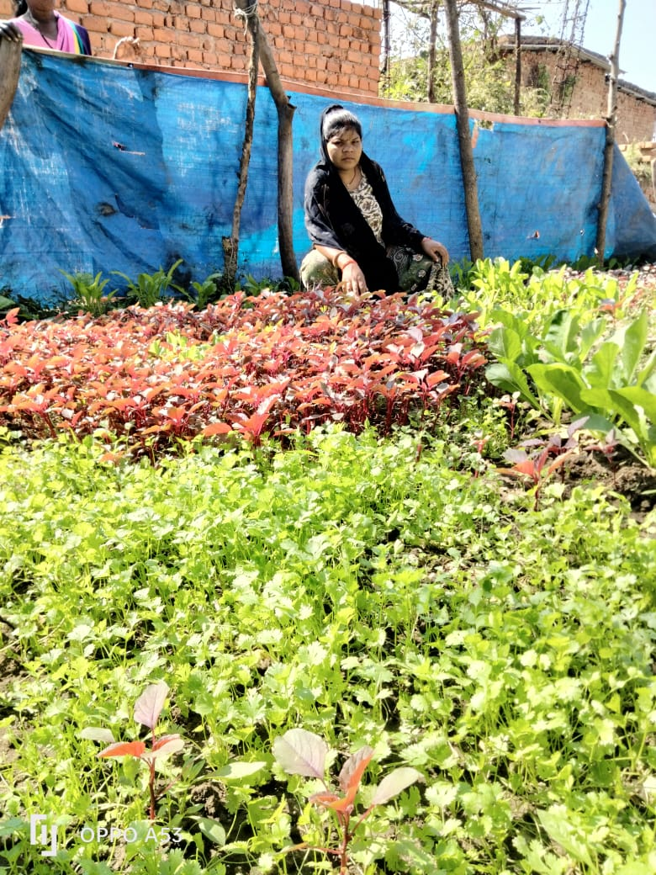
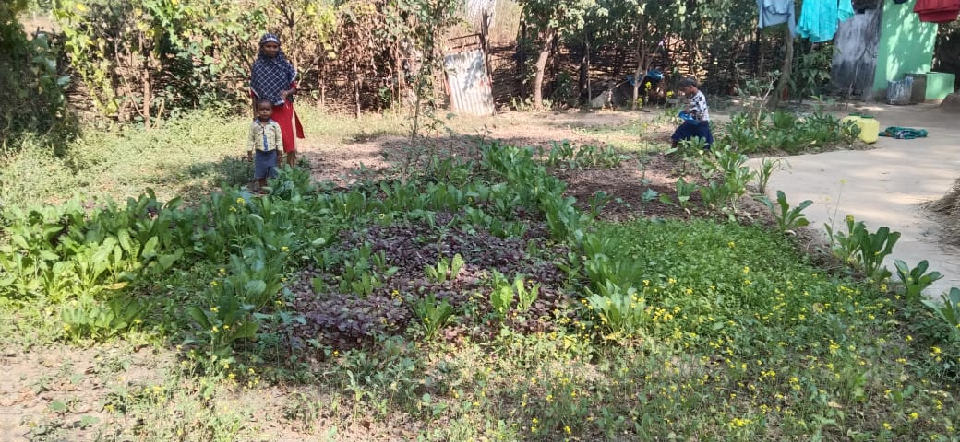
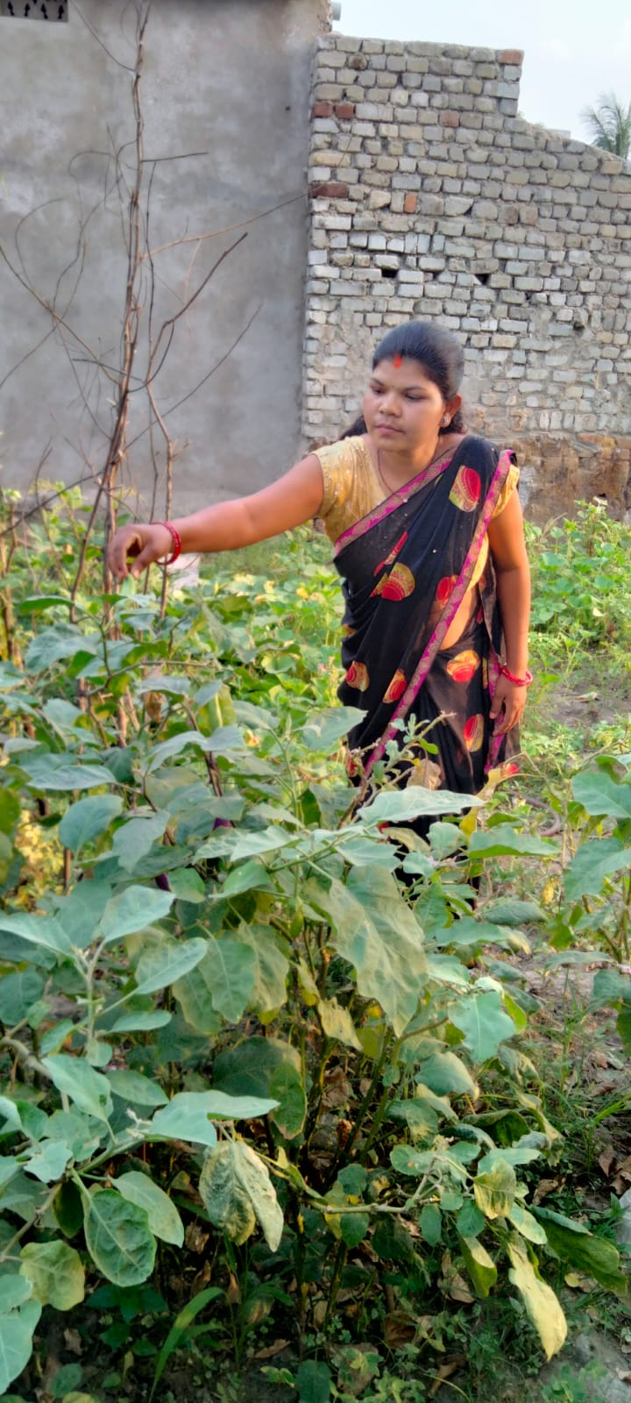
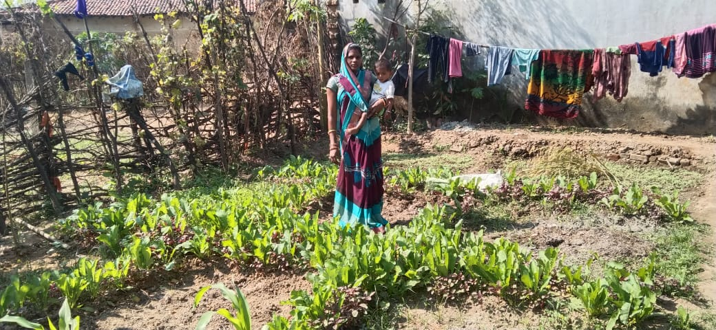
Kitchen Garden in HHs level

Slide 15
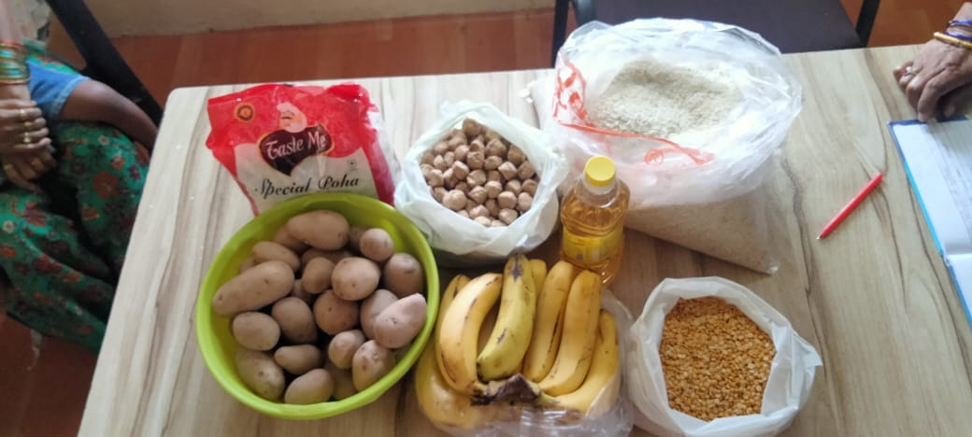
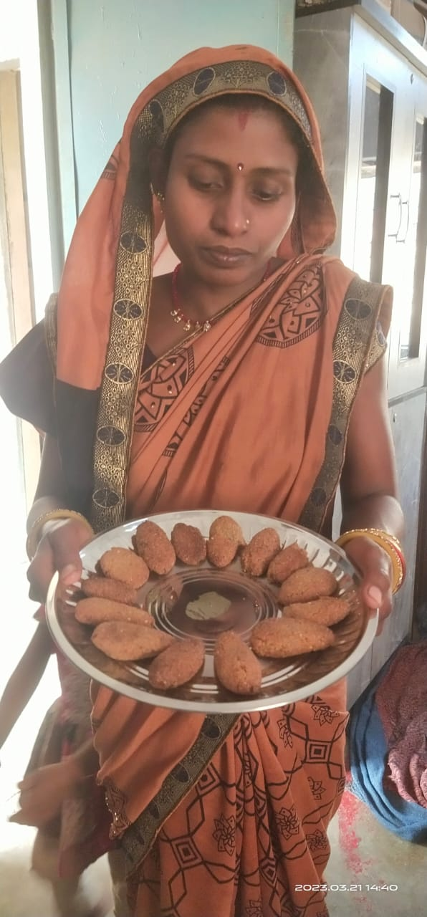
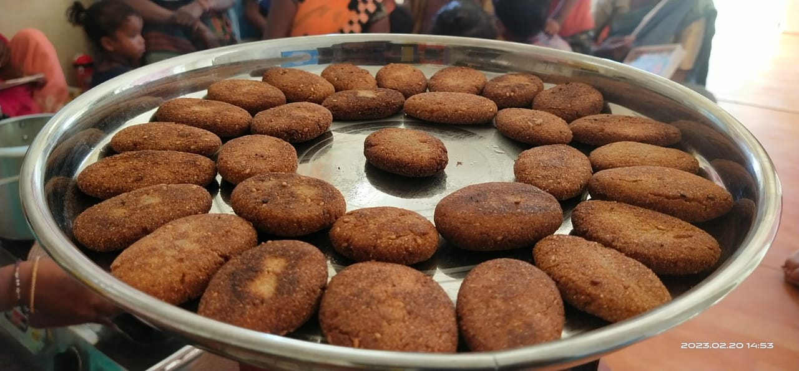
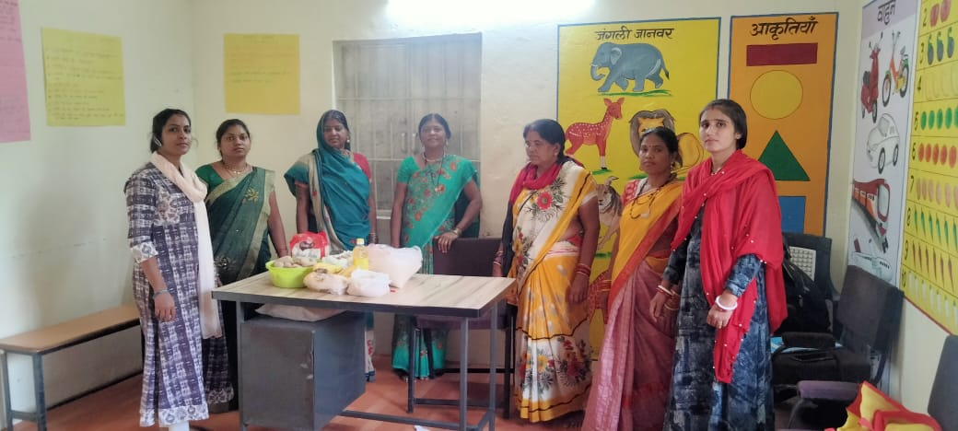
THR Recipes

Slide 16
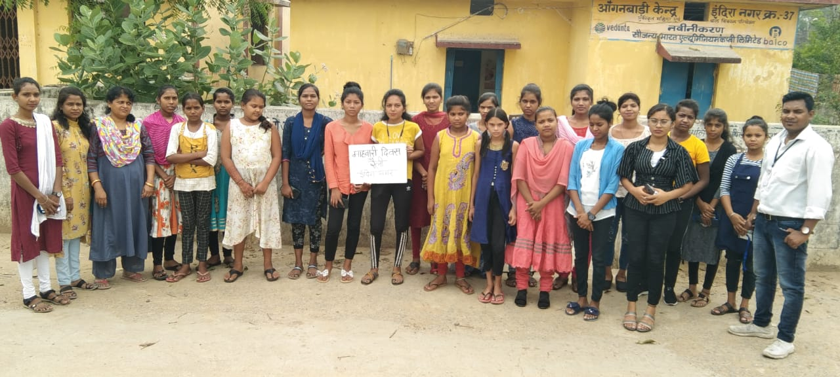
Proposed project plan

Slide 17
Thanks

